Slide 1
Famous Explorers
Christopher Columbus(Spain)
John Cabot(England)
Juan Ponce de Leon(Spain)
Vasco Nunez Balboa(Spain)
Jacques Cartier(France)
Henry Hudson(Holland)

Slide 2
What led Europeans to explore and settle the Americas in the 1400s and 1500s?
European explorers originally set out to look for a water route to Asia. Later, explorers wanted to find gold and glory and spread Christianity.
ECONOMICS! The explorers were seeking RICHES such as GOLD.
The explorers desired to spread religion(Christianity).
Explorers hoped to find valuable NATURAL RESOURCES(fish and trees).
Many for looking for excitement and fame

Slide 3
Explorers had OBSTACLES to overcome. An obstacle is anything that gets in the way or stops progress
No map or poor maps
Poor navigational tools
Dangerous uncharted waters
Running out of supplies during the journey
Different climates
Rough weather for long distances
Food was hard to find.
Many men died of starvation.
New diseases.
Crew fears and discouragement
Battles with Native Peoples

Slide 4
Accomplishments of Explorations
Discovery of new lands
Goods and ideas were exchanged by different people.
As explorations took place, navigational tools were improved.
Mapping of new areas
Improved transportation(ships)

Slide 5
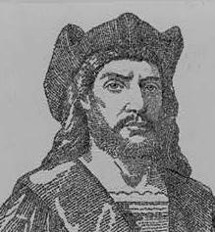
Christopher Columbus(Spain)
Columbus was the first European to reach the New World in 1492. He reached the Bahamas.
Queen Isabella of Spain sponsored Columbus’ voyage.
He was trying to sail to Asia to find riches.
Columbus believed he could find the West Indies by sailing west across the Atlantic Ocean.
Nina, Pinta and the Santa Maria were the names of Columbus’ ships.

Slide 6
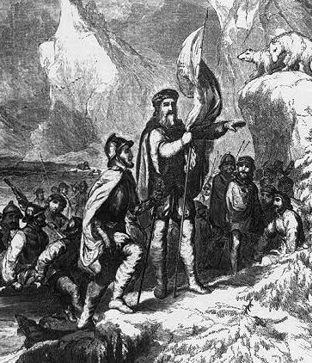
John Cabot(England)
England sponsored John Cabot’s New World expeditions.
The purpose of John Cabot’s voyage to the New World was to search for a Northwest Passage across North America to Asia (a seaway to Asia.)
Cabot explored the Canadian coastline and named many of its islands and capes.
Cabot Landed on the eastern shores of Canada in 1497 and claimed it for England.

Slide 7
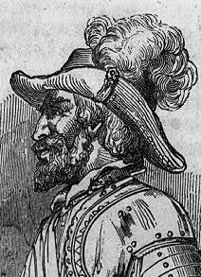
Juan Ponce de Leon(Spain)
Spain sponsored Juan Ponce de Leon’s New World expeditions.
Ponce de Leon Discovered Florida and claimed it for Spain in 1513.
Juan Ponce de Leon explored Puerto Rico and Florida.
He was searching for the “Fountain of Youth”.

Slide 8
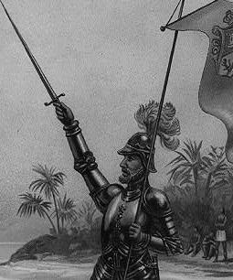
Vasco Nunez Balboa(Spain)
Spain sponsored Vasco Nunez Balboa’s New World expeditions.
Vasco Nunez Balboa was the first European
to see(discover) the Pacific Ocean from
the Americas in 1513
He was searching for wealth and fame.
He was put to death for treason.

Slide 9
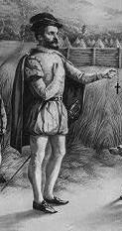
Jacques Cartier(France)
France sponsored the voyages of Jacques Cartier.
Cartier discovered the Gulf of Lawrence and St. Lawrence River in Canada in 1534.
Jacques Cartier led three expeditions to Canada. (Cartier named Canada “Kanata” meaning village or settlement in the Huron-Iroquois language.)
He was searching for gold.

Slide 10
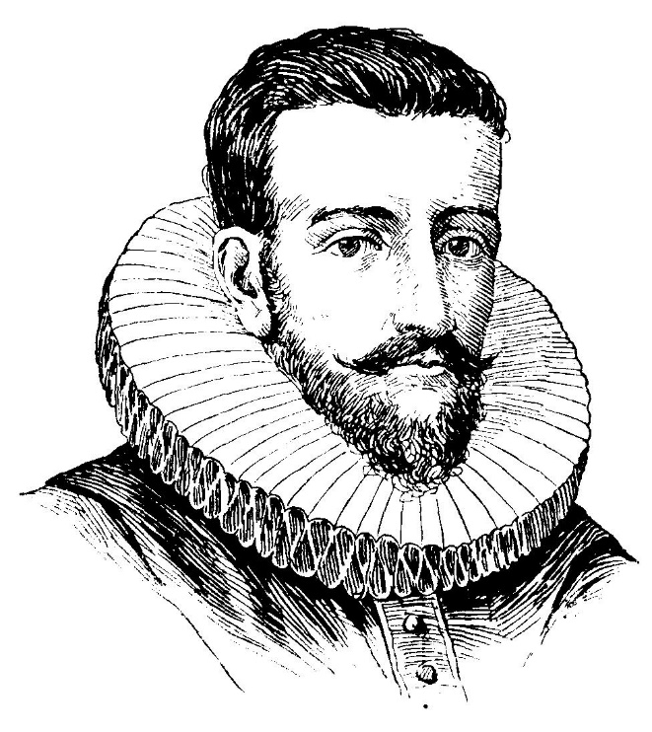
Henry Hudson(Holland)
Hudson explored the Hudson River near present-day New York State and the Hudson Bay in 1609 and 1610.
He claimed the area for Holland.
Henry Hudson explored parts of the Arctic Ocean and northeastern North America. (The Hudson River, Hudson Strait, and Hudson Bay are named for Hudson.)
Hudson was trying to find a northern path to Europe and Asia.
His final voyage ended in mutiny.

